Slide 1


Student workshop on the Quality
Enhancement Project

Slide 2
Aims of the workshop
To introduce students to the CHE and public policy affecting higher education
To introduce students to the Quality Enhancement Project (QEP)
To begin a conversation about how students can be involved in promoting student success
To identify ways in which students can be involved in the QEP
To select regional QEP student representatives

Slide 3
Post-school education
NQF
1
2
3
4
5
6
7
8
9
10
The White Paper on Post-School Education and Training (Department of Higher Education and Training, 2013) identifies the following institutions:
General education
Community colleges (including former FET colleges)
Private FET colleges
Further education
Technical and vocational education and training colleges (TVETs)
Government-funded, non-DHET post-school institutions
SETA-funded qualifications
Higher Education
Universities
Private Higher Education Institutions

Slide 4
Higher education
23 Public HEIs
Universities of technology
TUT, VUT, CUT, DUT, MUT, CPUT
Comprehensive universities
Venda, UJ, UniZul, WSU, NMMU, UNISA
Universities
Limpopo (MEDUNSA), Pretoria, Wits, NWU, Free State, UKZN, Fort Hare, Rhodes, UWC, Stellenbosch, UCT
New: Sol Plaatjie, Mpumalanga
About 115 Private HEIs
Small single focus to large, multi-focus; certificate to PhD

Slide 5
The Council on Higher Education
CHE is an independent, statutory body responsible for quality assurance and promotion. Its functions include:
providing advice to the Minister of Higher Education and Training on all aspects of higher education policy.
developing and implementing a system of quality assurance for higher education.
monitoring and reporting on the state of the higher education system.
contributing to the development of higher education through intellectual engagement with key national and systemic issues.
CHE is the Quality Council for Higher Education. It is responsible for implementation of the Higher Education Qualifications Sub-Framework.

Slide 6
Four components of the CHE’s work
Programme accreditation
ensures that minimum standards are met in HEI programmes
National reviews
specific programmes are evaluated and benchmarked nationally and internationally
Institutional audits
evaluate HEIs’ internal quality assurance mechanisms
Quality promotion and capacity development
training, information sharing and other development opportunities are provided to institutions

Slide 7
Key statistics for 2011
SA population 51.8 million
No. 15-19 year olds 5.0 million
No. 20-24 year-olds 5.4 million
No. HE students 938 200
20-24 year old participation rate 17%
Black African 14%
White 57%

Slide 8
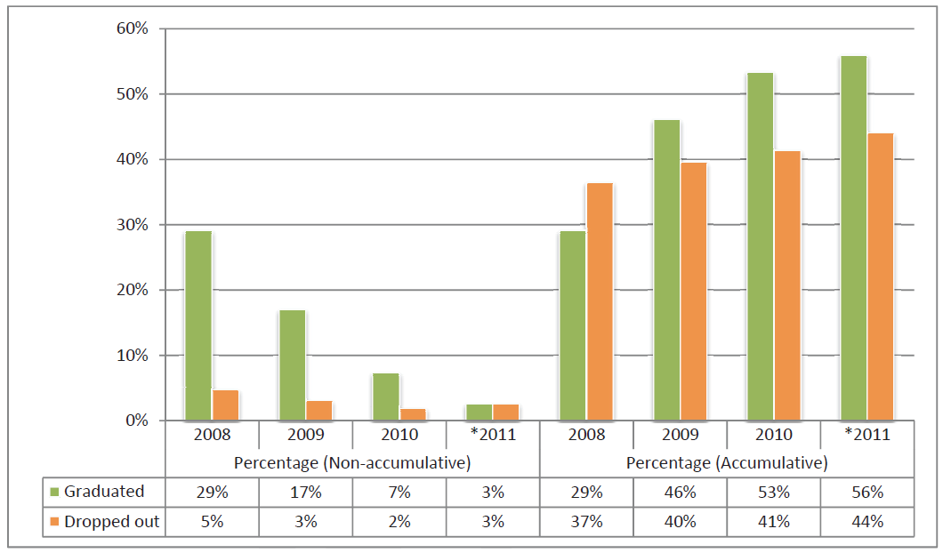
Throughput rates for 3-year degree 2006 student cohort in public HEIs (excluding UNISA)
(VitalStats Public Higher Education 2011, CHE)

Slide 9
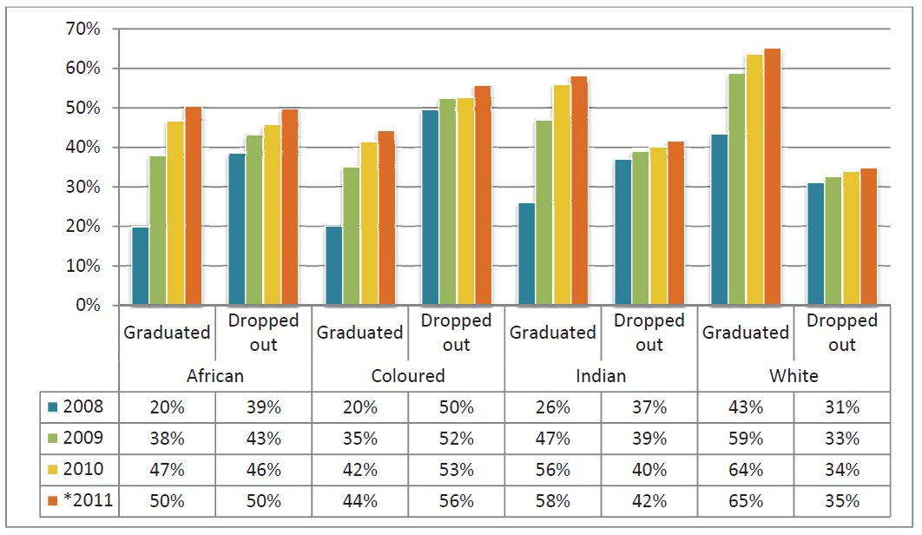
Throughput rates for 3-year degree 2006 student cohort in public HEIs (excluding UNISA) by race

Slide 10
National Development Plan 2012
“The data on the quality of university education is disturbing. South African universities are mid-level in terms of knowledge production, with low participation, high attrition rates and insufficient capacity to produce the required levels of skills. They are still characterised by historical inequities and distortions.”

Slide 11
OECD Sept 2012
Higher education can no longer be owned by a community of disciplinary connoisseurs who transmit knowledge to students. Both the complexity and uncertainty of society and the economy will require institutions to continuously adapt while upholding standards. In practice, institutions will have to learn how best to serve the student community. Students have become the focal point of our learning approach in many areas of the world.
(Fostering Quality Teaching in Higher Education: Policies and Practices)

Slide 12
Convergence of imperatives for change
Zeitgeist
Universities taking responsibility for their students’success
Students
National needs
Social justice,
Economic development
21st century skills
Inter-personal,
Information processing
Life-long learning

Slide 13
Quality assurance to Quality enhancement
Quality Assurance:
“the means through which an institution ensures and confirms that the conditions are in place for students to achieve the standards set by it or by another awarding body” (UK QAA),
Quality Enhancement:
“has defined enhancement as taking deliberate steps to bring about improvement in the effectiveness of the learning experiences of students.” (Scottish QAA)

Slide 14
The Quality Enhancement Project
The Second Cycle

Slide 15
Focus of the Quality Enhancement Project
The enhancement of student learning with a view to producing an increased number of graduates with attributes that are personally, professionally and socially valuable.
1. enhanced student learning, leading to an
2. increased number of graduates that have
3. improved graduate attributes
STUDENT SUCCESS

Slide 16
Collaboration is key
We need collective impact resulting from collective engagement– combining our knowledge, skills, wisdom and experience.
The problem is too big, too complicated, too important for fragmented, individualistic or ad hoc approaches.

Slide 17
Intellectual rigour is essential
“Despite years of effort, institutions have yet to develop a coherent framework to guide their thinking about which actions matter most and how they should be organized and successfully implemented. Too often, institutions invest in a laundry list of actions, one disconnected from the other.” (Vincent Tinto, 2012)
Efforts to promote student success need to be coherent, with a sound theoretical and evidence base.

Slide 18
Accountability is required
During the past several decades greater societal demands for accountability have prevailed. This has obliged universities to demonstrate that learning is taking place. A greater emphasis is placed on measuring learning outcomes; it is no longer sufficient to measure the "inputs"-what is being taught and how the curriculum is delivered to the students.
(UNESCO 2009, Trends in Global Higher Education: Tracking an Academic Revolution )

Slide 19
Approach
Institutions engaged simultaneously
Four focus areas identified to start with for first two years
Both individual institutions and collaborative groups of institutions will be involved
Inductive and iterative (two phases)

Slide 20
Role players
QE reps
HEIs
DVCs
CHE
PROF
BODIES
SAAIR
HESA
HELTASA

Slide 21
Both institutionally-based and nationally coordinated activities
Institutional enhancement
HE system enhancement

Slide 22
Process
Select focus areas
Institutional submissions
Analysis
Individual Institutional feedback
Feedback
Symposia, working groups
Collaboration
Projects of other bodies
Analysis
Research projects
Feedback
Institutional capacity development
Institutional reports

Slide 23
Enhancing…
Curriculum
Learning resources
Academics as teachers
Teaching
Student support
Student enrolment management
Assessment
Learning environment
Academic student support and development
Course and programme enrolment management
Non-academic student support and development

Slide 24
Focus areas for Phase 1
1. Enhancing academic as teachers
Including professional development, reward and recognition, workload, conditions of service and performance appraisal.
2. Enhancing student support and development
Including career and curriculum advising, life and academic skills development, counselling, student performance monitoring and referral.
3. Enhancing the learning environment
Including teaching and learning spaces, ICT infrastructure and access, technology-enabled tools and resources, library facilities.
4. Enhancing course and programme enrolment management
Including admissions, selection, placement, readmission refusal, pass rates in gateway courses, throughput rates, management information systems.

Slide 25
Phase 1 main activities (2014-2016)
2014
2015
2016
QEP launch (27 Feb)
QEP student workshop (4 Apr)
Institutional QEP committee identified
Institutional submissions (1 Sept)
Analysis
National QEP meeting
DVCs meetings
Collaborative group workshops
Analysis
National and regional QEP meetings
DVCs meetings
Institutional reports (30 Nov)
Select new focus areas
Feedback to each institution
Institutional submissions (Phase 2)
Analysis
QEP meetings
DVCs meetings

Slide 26
Expected outcomes of the QEP
Benchmarks and codes of good practice for quality undergraduate provision
Policy recommendations
Tools and resources for improving student success
Research
Communities of practice
Raise the bar for what can be expected of institutions in promoting student success in future

Slide 27
Broad desired outcomes
Enhancement of the quality of undergraduate provision
Enhancement of the quality of graduates
A higher education system that is improving continuously as members of the higher education community collaborate to share good practice and solve shared problems.

Slide 28
“Student success does not arise by chance. Nor does substantial improvement in institutional rates of student retention and graduation. It is the result of intentional, structured and proactive actions and policies directed towards the success of all students.”
(Vincent Tinto 2012)

