Slide 1
Lessons Learned: Student Success Arises One Class at a Time
Regional Symposia on Student Success
Cape Town, South Africa
August 23, 2013
Vincent Tinto
vtinto@syr.edu

Slide 2
Promoting Student Success
Focusing the attributes of classrooms that promote student success, especially during the first year of university study.
2

Slide 3
Conditions for Classroom Success
Expectations
  Clear, consistent, accurate information
  High expectations
3

Slide 4
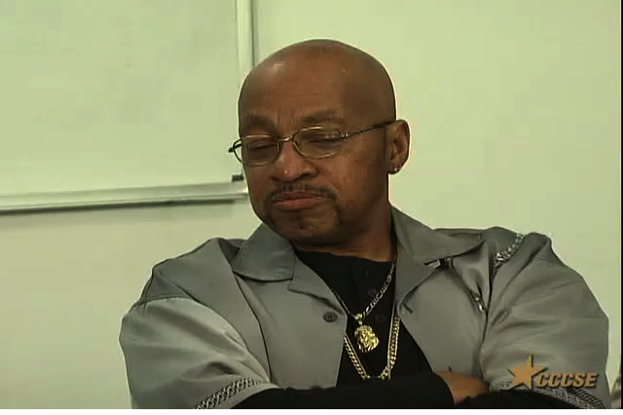
View video clip online:
http://youtu.be/qhWztGhdHk0
4

Slide 5
Promoting Classroom Success
Expectations
    Support
      Student success course
      Contextualized academic support
        Supplemental instruction
        Embedded academic support (I-Best)
        Basic skills learning communities
5

Slide 6
Supplemental Instruction (SI)
Mathematics
Instructor
Supplemental
Study Groups
A
B
C
D
Tutor A Tutor B Tutor C Tutor D
6

Slide 7
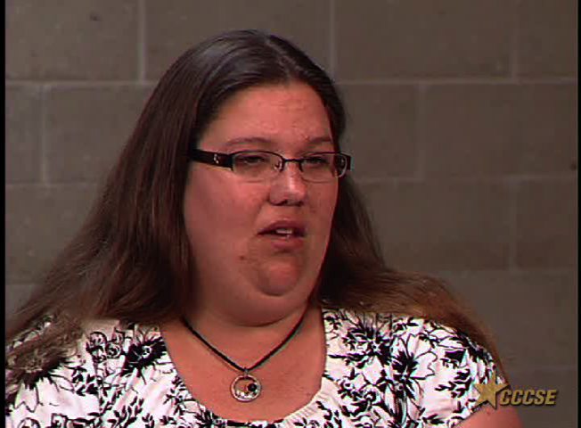
View video clip online:
http://youtu.be/1WfmSBf3hkM
7

Slide 8
LaGuardia CC - ESL Linked Courses
ESL English
Accounting
8

Slide 9
“The relationship between accounting and ESL is helping a lot because the accounting lecturer is teaching us to answer questions in complete sentences, to write better. And we are more motivated to learn vocabulary because it is accounting vocabulary, something we want to learn about anyway. I am learning accounting better by learning the accounting language better.”
9

Slide 10
Promoting Classroom Success
Expectations
Support
Assessment and Feedback
  Entry assessment and placement
  Early warning
    Predictive Analytics
  Classroom assessment
    One-minute paper
    Automated response systems
10

Slide 11
Conditions for Classroom Success
Expectations
Support
Assessment and Feedback
Engagement
  Contact with students, lecturers, and staff
  Active engagement in learning with others
  Intensity / time-on-task
11

Slide 12
Promoting Classroom Success
Expectations
Support
Assessment and Feedback
Engagement
  Pedagogies of engagement
    Cooperative learning, Problem/Project-Based learning
    Service learning
  Cohort programs
  Learning communities
12

Slide 13

View video clip online:
http://youtu.be/sqELX7yqu98
13

Slide 14
“You know, the more I talk to other people
about our class stuff, the homework, the tests,
the more I’m actually learning... and the more
I learn not only about other people, but also
about the subject because my brain is getting
more, because I’m getting more involved with
the other students in the class. I’m getting more involved with the class even after class.”
14

Slide 15

View video clip online:
http://youtu.be/d10-N0-cEUw
15

Slide 16
Closing Thoughts:
Closing Thought
  Student classroom success does not arise by chance. It requires intentional, structured, and proactive action that is systematic in nature and coordinated in application.
16

