Slide 1
Enhancing Strategic Enrolment Management
CHE Codes of Good Practice Guide
SEM Team

Slide 2
The big question 1 (inside – out)
Internal Conditions
Internal Resource Capacity
PQM
External Vectors
NDP
Academic Mission
DHET Imperatives
Scarce Skills
Socio-Political Drivers
What is our optimal enrolment size, shape and profile given

Slide 3
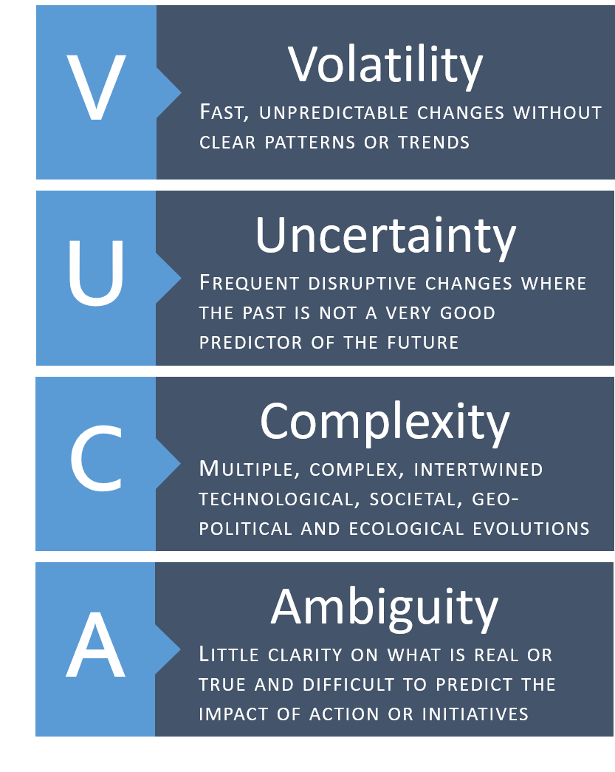
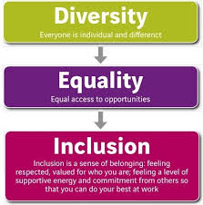
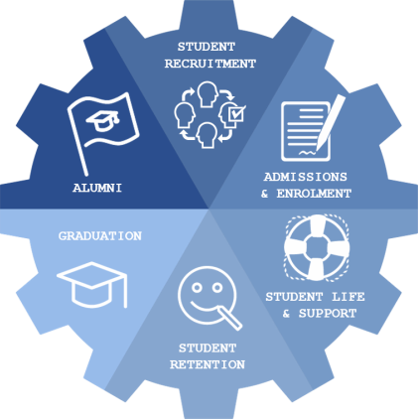

The big question 2 (outside – in)
How do we define our relationship with our student?

Slide 4
Aligning planning
External drivers
PESTLE
Institutional mission
Academic Plan
Staff & Student Profile
Institutional Arrangements
Resource Allocation Model
Infrastructure, Technology & Information
Organisational Structure
Knowledge Production
Stakeholder Engagement
Internal Human Capacity
Notes:
….. Period of relative drift and discontent…two resigned, one for personal impropriety and the other for unpopularity with students
Terms marked brevity, student discontent and occasional tumult
the discontent spilled over.
expulsion of students
The immediate cause … factional brawling was only the tip of an iceberg of dissatisfaction that had manifested itself for years in large-scale … fights and destructive pranks.
(Christenson, C.C. & Eyring, H.J. 2001. The Innovative University: changing the DNA of higher education from the inside out. San Francisco: Joss Bass

Slide 5
A working definition of SEM
SEM is a strategic objective driven by the mission and purpose of the institution, enabled by a holistic set of institutional arrangements, which defines the nature of its relationship with its students with student success as the key outcome.
Mission
Student Success
Institutional Arrangements
Optimum enrolment

Slide 6
SEM Core concepts
Mission driven (redefined, given the cataclysmic changes).
Enrolment goals embedded in the strategic plan.
Origins in the academic context and the PQM.
Prepares students for rapid technological changes.
Premised on an institutional culture of student engagement and success.
Dependencies on institutional capacity and external drivers
Founded upon an enhanced business capability model
Key role-players engagement and collaboration
Data driven decision-making and enhanced services.
Underpinned by institutional research

Slide 7
A Systems tHINKING approach
incorporate multiple perspectives;
Wicked problems, fuzzy boundaries
Diverse, loosely-coupled systems
Inter- and intra-relationships and dependencies;
Complex system behaviours
Reliably predict the impact of change to the system.
systems thinking begins with a goal and/or purpose, an exposition of the constituent elements or characteristics and the interconnections between the elements to incorporate multiple perspectives
Arnold and Wade (2015)

Slide 8
What are the good things that all universities should do
Executive management leadership
SEM underpinned by social justice and transformation
A systems approach to SEM (integrated planning)
Comprehensive SEM Policy framework
Map the entire SEM value-chain and business capacity
Re-design services, functions and structures
Responsive monitoring system
“Gateway courses” informed by curricula and pedagogical principles

Slide 9
What are the desirable things for universities to do
Adopt an holistic institutional perspective
Data capacity building workshops
Real-time student tracking system
Online applications and registration
Reliable and trustworthy data
Seamless integration with Basic Education and Industry Single access point to Admission, Registration, HEMIS Heads, Grads, Dropout
Data management teams and committees
Data dictionary

Slide 10
What are the noteworthy things universities could
Real-time data-driven decision making
Structured data analytics interface
Nuanced approaches to new and continuing students

Slide 11
What practices are rare or absent in SA?
Personalised student experience is a key differentiator for universities.
Customer relations technologies (CRM)

Slide 12
Concluding remarks
A systems approach may overcome the silo and uncoordinated practices in SEM as it begins with a goal, namely student success, and then defines the roles, responsibilities and interconnections between the key role-players towards the achievement of the stated goal.

