Slide 1
Code of Good Practice
A practical guide
Focus Area 3:
Enhancing the learning environment

Slide 2
Overview
Group Focus:
  Teaching & Learning Spaces
  Learning ICT Infrastructure, access and support
  Libraries and information literacies
  Technology-enhanced teaching and learning
  ‘Training & Support’ for Teaching & Learning with Technology
  **Overlap of key concepts & integrated processes (within group & other focus groups)
Outline:
  Key guidelines,
  Good practices,
  Desirable, and
  Noteworthy/ or rare practices

Slide 3
A. Teaching and Learning Spaces
Designs should be based on learning principles and the pedagogies that nurture holistic student engagement (Bonk, 2016)
Shifts in contemporary education demanding re-consideration learning spaces (Oblinger 2006):
  a more collaborative pedagogy
  changes in the qualities of students
  innovation in educational technology

Slide 4
the need to create flexible learning spaces
Five qualities of flexible educational spaces allowing for different functions within these spaces (Monahan 2002):
Fluidity: the ability of a space to permit the flow of people, light, sight, sound, and air through the space
Versatility: the ability of a space to be used for multiple purposes;
Convertibility: offers ease of adaptation for various uses
Scalability: space’s ability to expand or contract as necessary
Modifiability: invitation of active manipulation within a space

Slide 5
Guiding principles for conceptualising teaching and learning spaces
The design of more formal physical and online “spatial types” – alignment with educational philosophies - encourage collaborative and engaged learning
Recognise the urgent need to upgrade lecture venues – however upgrading with expensive venue equipment - will not necessarily solve problems
New spaces – careful planning for large student groups
Student residences and ‘near’ university off-campus living should be viewed as a seamless part of students’ learning experience

Slide 6
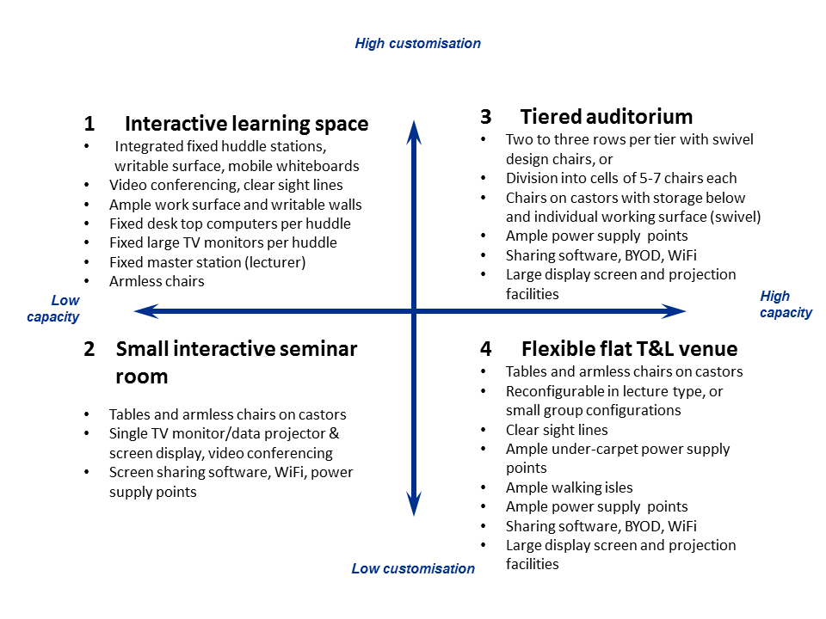
reconfiguring learning spaces
NWU Reconfiguring Learning Spaces:
Active and collaborative learning
Student-faculty interaction
Enriching educational experiences
Supportive campus environment
Level of academic challenge
Key drivers
G I du Plessis, NWU (2017)

Slide 7
Good practices: all universities should do…
Physical infrastructure (“the plant”)
24/7 safe and secure learning spaces available to all students
Optimal use of open and unused indoor and outdoor spaces
  Vaal University of Technology -“disability unit” - additional facilities - a braille room
  Universities – Venda & Limpopo - repurposing existing buildings and “dead-spaces”
  Limpopo & UJ - outdoor learning spaces with Wi-Fi hotspots - added tables and chairs in large passages and unused corners, as well as outside under trees and canvas gazebo
  CUT - utilised green spaces- removal of tar roads – replacement with plants, paving and benches.
Join forces with other universities and local authorities to create new spaces
  UNISA, Walter Sisulu University and Fort Hare University – collaboration - build a library in East London

Slide 8
Good practices: all universities should do…
Digital learning spaces
Provide a stable, reliable, scalable, and accessible LMS
  Universities - critical upgrades - and switching to single LMS
  UWC - migrating Student Administration System to a Microsoft.NET platform - promote stability
  VUT - migrating to one system (Blackboard) - cloud hosted - stability
Design online learning resources to cater for all demographics [students without Internet access at home, disabled students, and students without their own devices]
  UNISA – and Correctional Services – enable incarcerated students to gain access to the institutional LMS
  Rhodes University is developing a “digsnet” system – enable students to access to University’s Internet from some buildings in town
  A number of universities are providing first-year students with devices such as laptops or tablets.

Slide 9
Good practices: all universities should do…
When planning and designing new or redesigning learning spaces, involve all role players and stakeholders
  Facilities and Infrastructure Planning, T&L units, Faculties, Time-table committee, ICS and ‘student voices’
  Venue use should be organised centrally for lecturing timetable
DESIRABLE PRACTICES
Spatial design of lecture venues should be versatile, modifiable, flexible, allow flow; and be amenable to eLearning
  Rhodes University – shift away from building large lecture venues – focus on flexible spaces that can be used in different ways

Slide 10
Noteworthy Practices
Design of specialised spaces
  UniZulu - Simulation laboratory for nursing students
  UJ - ‘Resolution Circle’ where engineering students do some of their WIL
Learning spaces in residences are available to non-resident students
  Stellenbosch University - non-resident students can use study spaces in student residences
  Creation of ‘clusters’ to accommodate day and private students – provision of meals and study areas

Slide 11
B. Learning ICT Infrastructure, access and support
Higher Education has become more and more dependent on ICT as it is a facilitator of knowledge creation and communication
ICT has become crucial in the support, sustainability and growth of higher education institutions (King III Code, 2009)
ICT Infrastructure, access and support for higher education – still unequal – impact on student success rates
Digital fluency extends beyond the mere understanding of how to use technology
Training provided should also aim towards generating a deeper understanding of digital environments, enabling intuitive adaptation to new contexts and co-creation of content with others (Adams Becker et al. 2017:2)
Increased reliability on ICT infrastructure - brings with it an increase in responsibility and accountability to institutions

Slide 12
Risks & Governance
Risks involved in ICT have become significant
ICT governance has been dealt with in detail in the King III Code for the first time – various standards and codes of practice
Tight linkage between ICT and organizational processes - ICT unit cannot bear sole or even primary responsibility for the effective use of ICT
ICT is thus an increasingly important organizational competency – leaders across the institution (Weill & Ross, 2004, p. 3)
NB: Student systems used in the public higher education environment cover all aspects of student administration from registration to examination, finance and even residence administration

Slide 13
  GUIDING PRINCIPLES
ICT infrastructure, access and support activities that contribute to teaching & learning can be categorised into governance, infrastructure, services and support facets – dependent on one another
Reliable and sustainable infrastructure and resources that support the TAL initiatives
Good governance and conformance to relevant legislation
Provide policies and procedures to academics in the use of technologies for teaching activities
Provide relevant and applicable support structures for both the staff and student context
Do not rush technology deployment when considering new institutional wide resources such as a platform provider

Slide 14
Good practices: all universities should do…
Ubiquitous access to Wi-Fi and charging points
ICT helpdesk support
Governance and security
International standards and codes of practice
  Include project management methodology for ICT projects
A business continuity strategy that supports T&L strategy to ensure continued online T&L during times of unrest, natural disasters, system outages etc.
Join national bodies as participating members

Slide 15
desirable PRACTICES
Designated teaching and learning coordinators in faculties
  University of Stellenbosch, for example - advisors in each faculty - help integrate learning technologies into curricula
E-tutors for blended and fully online courses
  UNISA has specific course-related e-tutors that facilitate online discussions and explain course-related material
Selectively promote new technologies
  Lecture recording and web conferencing
  Office Mix that enables an academic to makea recording at the comfort of their desk
  NWU is using ‘Opencast’ software to live stream lectures, which are then uploaded onto the LMS for unlimited playback
  Web Conferencing tools becoming the norm
  UWC - piloting an interactive digital lecture capture that also doubles as a streaming and archiving service

Slide 16
desirable PRACTICES
Free software
  Take advantage of free services offered to the higher – software packages and cloud storage; and a range of Google Applications
Wi-Fi printing from any devices
  Increase ease of access to facilities while simultaneously freeing up the pressure on computer laboratories
3D printers
  3D Printers can for example be used to reproduce academic aids for laboratory environments at a fraction of the cost it would have been to import it from an international proprietary supplier
Institutional repositories
  Storing and re-using resources, with appropriate quality standards for learning objects
  Make use of student data to implement learning analytics [micro and macro level / various systems available - students with high risk profiles]

Slide 17
Noteworthy PRACTICES
Solar energy
  UNISA - plans for solar panels at regional centres - try combat connectivity disruptions
Zero rating
  Partner with other institutions to approach service providers – for reduced or zero rated services to students
  UNISA has provisioned discounted data bundles for student use
  NWU has also negotiated cheaper data for students, with a service
  UNISA has negotiated “provision of computer devices at reduced costs to students through PURCO” (CHE review).
Alignment of High Performance Research Clusters
  Allow for ways to optimise existing infrastructure and resource sharing.
Corporate social development opportunities
  Provide devices to students through sponsorship agreements
UJ -provides all incoming first-year students with a tablet

Slide 18
Rare/ or absent PRACTICES IN sa
Making use of artificial intelligence to drive resource constraints
  Automated helpdesks
  UWC - mobile app that provides easy access to their LMS
Establish Steering Committee that investigates emerging tech
  UJ - an IT advisory committee, as well as the Centre for Academic Technologies
Collaboration between institutions
Organisational alignment of business and ICT
    Few institutions have an end-to-end view of processes, resulting in the disparate use of technology
Conducting an Intellectual Property Audit to protect your intellectual property assets

Slide 19
C. Libraries and information literacy
Learning environments should “promote student success and advance intellectual, social, and emotional growth of students” (DUT 2014:25)
Design Libraries – find a way to integrate technology & complement traditional printed resources… Library – should fulfil its role as a ‘teaching and learning instrument’ (Bazillion 2001: 51)
Early models - information commons & learning commons
Recent model is the Library Learning Space:
“…try to connect students to technology, information, and co-curricular learning- learning that deliberately complements the formal classroom activities, programs, and experiences that contribute to student learning” (Head 2016: 9)

Slide 20
Guiding principles
Libraries are becoming more hybrid - a blend of social, physical; and digital spaces and services (Head 2016: 10)
Collaborative Spaces: Users collaborate – projects - brainstorm ideas, practice presentations, etc.
Interdisciplinary: Include equipment, spaces, and services - supporting/representative of various disciplines
Flexible: Allow for the reconfiguration of a space (short notice based on needs)
Functional: Collaboration, individual study, point-of-need services, or “occasional” sessions taught by academic staff
Active learning: A space where students can actively engage with the course material, both collectively and individually
Comfortable/welcoming: Feeling of a “campus living room”

Slide 21
Guiding principles
Open areas - to minimise physical barriers, remove private offices, emphasise collaboration
Safe and secure space: Including storage/lockup facilities
Social Space - collaboration, conversation, and informal learning
  Stellenbosch University - “designing the living and learning environment as one seamless environment” – aim to give students - rich, cultural student life (CHE review)
Transparent: “An approach to showcasing learning activities taking place in a space through open concepts, low-profile technology and furnishings, and limiting physical barriers that might otherwise obstruct a user’s open view” (Head 2016: 10).
Creative: A bright (“modern coloured”) space to foster creativity (seeing libraries as creation hubs)
Digital: Developing students’ digital citizenship includes mastering technology usage – online identity, communication etiquette, and rights and responsibilities (Horizon report 2017: 22)

Slide 22
Good practices: universities should do…
User-centric spaces that allow for individual and collaborative learning
University of Limpopo - 24/7 reading room – safe study facilities
University of Venda – library - dedicated space for group work and peer-learning
Vaal University of Technology - various libraries on the different campuses - open on weekends - students can book venues for group work
University of Cape Town is also provisioning 24/7 study areas
University of Kwa-Zulu Natal - learning spaces are being repurposed for both individual and group learning
University of the Western Cape provides “silent study areas, discussion rooms, meeting rooms, Knowledge Commons, Reading room, reference desks, self-learning zone, disabled student centre, print & go kiosks, and training rooms”
Stellenbosch University- refurbished - “vibrant and attractive physical and virtual space that promotes collaboration, social networking”

Slide 23
Good practices: universities should do…
Switch to digital resources
Several universities - Increasing amount of electronic resources – incorporation of Lib Guides into online systems
  University of Limpopo, the University of Venda, Wits University, Walter Sisulu University, University of the Western Cape, the University of South Africa, Stellenbosch University
  North-West University has an integrated library website that ensures seamless access to electronic resources (CHE review)
  University of Johannesburg follows an “E First Strategy” with regard to e-textbooks and open-source textbooks

Slide 24
Good practices: universities should do…
Ubiquitous access to fast Wi-Fi and power points/charging stations
University of Limpopo - Wi-Fi is available, and hotspot technology for students with their own devices is being researched and implemented (CHE review 2017)
Walter Sisulu University library has 24 hour walk-in-walk-out labs, internet and reading labs with approx 500 seats
Central University of Technology (CUT) - implement outdoor learning spaces with access to solar charging stations and increasing Wi-Fi access (CHE review)

Slide 25
Good practices: universities should do…
Learning Commons: “Full-service hubs for learning, research, engagement, and collaboration within the library” (Head 2016: 8)
“Everyone is a learner; everyone is a teacher working collaboratively toward excellence” (Leading Learning 2014: 5)
University of Limpopo - learning commons - “enable provision of content and other supporting materials for students” (CHE review 2017)
Stellenbosch University - learning commons - with ubiquitous access to Wi-Fi
Walter Sisulu University campuses - interactive learning commons exist – serves under and post graduates – “training hubs and research clinics”
UWC – ‘Knowledge Commons facility’ - additional software and equipment for disabled students; and co-curricular programme - current affairs, culture, heritage & ethical issues
UJ - dedicated subject librarians - linked to different course modules in order to “ensure a direct library presence” (CHE review 2017)

Slide 26
Desirable practices
Library Learning Space - a progression from learning commons (Head 2016: 9)
  University of the Western Cape provides “a cross-faculty service division, access to more than 100 PC’s in the Knowledge Commons, PC workstations and laptop-friendly spaces throughout the library, and 30 print & go kiosks allowing students 15 minutes to read emails, download documents to email, or print assignments” (CHE review 2017)
Most of the library’s spaces allocated for student use
  Virginia Commonwealth University’s library has dedicated 90% of the space to student use (Horizon report 2017: 17)
Research data management
  Store and track user data and research – to improve services – and for data management (identification and access)

Slide 27
Noteworthy PRACTICES
Digital Tool Shed
  Claremont Colleges Library, a Digital Tool Shed is being constructed, which is “an incubator for innovative digital research, teaching, and learning” Horizon Report (2017: 17).
Mobile Libraries
  University of South Africa - offers mobile libraries in the Western Cape and Limpopo
Libraries – adoption of a matrix-like organisational structure (Horizon report 2017: 28)
  Bring teams of experts together from various functional areas – engage in projects
  Encourages collaboration, integrated services and interdisciplinary approaches to problem-solving
  University of Manchester Library – move away traditional subject-based team model – to three function-based teams, research services, teaching and learning, and academic engagement

Slide 28
Noteworthy PRACTICES
Innovation Learning Studios (Makerspaces)
  Evolving needs of library users; available online resources; and lecturers encouraged to build “vibrant learning community” (Horizon Report 2017: 16)
  Montana State University Library - Innovation Learning Studio (ILS) – attract academic staff - an additional educational space - enables more “active teaching, flipped-classroom opportunities, and new technological explorations”
  Emphasis: Notion of “ideas over technology” is further emphasised, and so is the concept of makerspaces
  Pedagogical shift – staff and students create content rather than – consume information
  University of Pretoria has a Makerspace in the library - access to 3D printers and scanners

Slide 29
Noteworthy PRACTICES
Collaborative libraries - regional collaboration
  International example - functional academic library consortium is OhioLINK (https://www.ohiolink.edu/)
  OhioLINK negotiates for and manages more than $30 million worth of high-quality, peer-reviewed research articles on behalf of over 120 member libraries serving more than 450,000 students, faculty and researchers across Ohio
  Consortium also shares all their physical and e-books, etc .
  Rhodes University hosts the Eastern Cape Consortium - shares a common library management system - in turn saving resources by sharing them (CHE review pg 20).

Slide 30
Noteworthy PRACTICES
New storage and curation methods
  Collections - expansion to include journal articles, dissertations, e-books, reports, and digital assets
  Integration of library offerings into academic teaching and learning programmes
  Wits University – offers faculty-based information-literacy programme – 1st yr students [includes lectures and online tutorials and tests accessible on Wits-e]
  Librarians at UWC - offering presentations on digital apps - and creating an “online ‘sandbox’ of resources [ “includes strategies for modelling knowledge practices in lectures, and examples of learning activities and assessments”]

Slide 31
rare or absent in SA
Emporiums
  Virginia Polytechnic Institute and State University (Virginia Tech) - Math Emporium - learning centre consisting of 537 Apple computer workstations - arranged in hexagonal pods
  “Students can work at small tables or relax on comfortable sofas in one of two lounges. Wireless internet and power strips are available in all areas of the Emporium for laptop use” (www.emporium.vt.edu/)

Slide 32
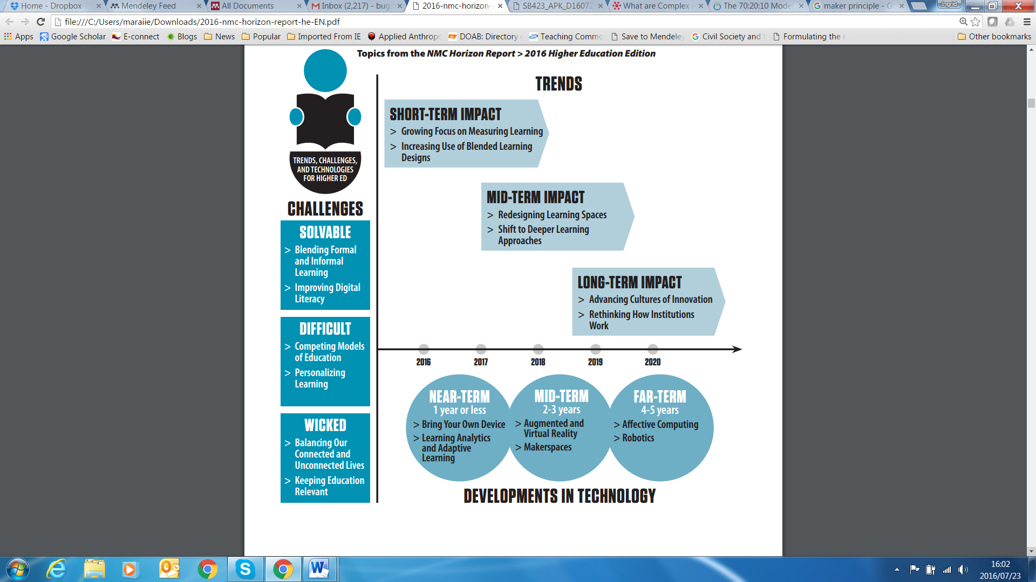
D. Technology-enhanced teaching and learning
Shift from computer-based technologies for personal use, to cloud-based technologies and more collaborative use
The New Media Consortium - indicates as the latest technology trends, developments and challenges for the higher education sector in 2016 over the short-term, mid-term, and long-term (Johnson et al 2016)

Slide 33
Guiding principles
Visible
  Increase visibility to students to combat passive learner role
Organised
  Increased time management responsibility of the learner means increased organisational responsibility of the teacher
Compassionate
  Foster a compassionate learning environment
Analytical
  Ensure achievement of learning outcomes by continuously analysing student data
Learn-by-example
  Teacher should try to model the best strategies for aiding learning

Slide 34
Guiding principles
Technology is a tool for learning
  Use as a ‘mediator in learning experiences’
Technology should be learner-centred
  Personalization, connectedness, collaboration and contextualization is central to the T&L environment
Social justice, equity and inclusivity
  Shift to openness of knowledge in order to ensure the democratization of learning
Relevance to context
  Necessary for a relevant and authentic learning experience
Collaborative
  To ensure instant communication that ensures connectivity between students and teachers
Reflection
  To ensure students and teachers are drivers of authentic learning
Research & scholarship
  To engage in constant research and scholarship - on and of - teaching and learning of and with technology

Slide 35
Good practices: all universities should do…
Excellent design of learning material
  University of the Free State - learning designer and a technical developer - in each faculty- encourage effective use of blended learning.
  UFS - audio-visual production facility that increases access to teaching and learning content
Enable and empowering students towards digital fluency
  Some universities - providing all incoming first year students with tablets or laptops - and digital orientation programmes [use of the technology]
  UJ has a mobile application, uGo, that “supports transitions into and out of the UJ community”, as well as uLink – “a single sign-on portal that staff can use as a management tool for workshop bookings, consultation bookings and recording class attendance” (CHE review 2017).
Use pedagogies and technologies to encourage authentic collaborative learning

Slide 36
Good practices: all universities should do…
Software could assist with the identification of plagiarism (automated similarity checking)
  However, better to design assignments that discourage copying and pasting
Early/ “in-time student support”
  Learning analytics linked to the SIS and the LMS – student depends on the response
  Planned interventions are essential - through advisors and tutors
Flexible learning - enabled through a blended learning approach
  Variation of face-to-face and online learning designs are integrated.

Slide 37
Desirable practices
Contextualised and appropriate open educational resources
Form CoPs around shared experiences
  Peer-learning & support; showcasing successful and good practice on how to use LMS and other tools in university for others to learn
  UWC – integrated Digital Academic Literacy programme - which equips students with basic academic literacy skills in software packages such as Microsoft Word, Excel, email, Internet browsers; and eTools (within the LMS)
  University of Kwa-Zulu Natal is producing instructional videos in isiZulu and making them available online - including on how to use the institutional LMS, Moodle
Learning analytics
  Real-time tracking of students, dashboard monitoring to give students additional support as soon as a problem has been identified

Slide 38
Noteworthy PRACTICES
Rare/ or absent in SA
E-books as a solution to accessibility
  students use - mobile phones to read anywhere and at any time
LMS as virtual office space
  CPUT report on the value of paperless meetings as a response to environmental ethics and also the convenience of it
An all-inclusive teaching and learning environment (ICTs, interchangeable space, support, collaborative etc.)
  WeThinkCode - organisation that teaches students to learn to code; the environment is teacher and class free thus students are empowered through peer-learning and self-learning

Slide 39
E. ‘Training & Support’ for Teaching & Learning with Technology
Training and support of the use of ICTs are necessary for current teaching and learning practices
Planned and well integrated training and support for lecturers will impact the overall teaching and learning experience of ICTs
However, “the effective integration of ICT into learning and teaching depends to a large extent on the lecturer’s vision, skills and buy-in into the process” (Stellenbosch University 2013:18)

Slide 40
Guiding Principles
Vision – The institution must be clear on the pedagogies of teaching and learning
Planning – Both educators and professional support staff must be engaged in the “assessment, implementation and revision” of institutional plans related to effective use
Access – Ensure equal access to “hardware, software and connectivity” that supports vision
Integration – Professional support staff must model best practices and should be responsible in ensuring that both students and teachers are able to assimilate technology into their daily practices
Assessment and Evaluation – Assessment and evaluation are both imperative for feedback, decision making and continuous development of authentic teaching and learning practices

Slide 41
Guiding Principles
Support – Professional support staff must ensure continuous pedagogical and technical support and maintenance of technology within the institution
Professional Development – Support staff must provide meaningful and continuous professional development
Community Relationships – Support staff must be responsible for establishing “community relationships” to ensure the collaboration in “planning, implementing and assessing the use of technology”
Ethical and Legal Issues – The institution must have a policy to ensure the understanding of ethical and legal issues associated with the use of technology

Slide 42
Good practices: all universities should do…
Education Consultants & Instructional Designers: Alignment of strategies with UP 2025 – strategic five year plan; and annual teaching and learning plans of the institution and faculties
Integrated teams: Instructional Design, Digital Academic Literacy, Software Development and Application, Materials Development, and Research (UWC)
Alignment of scholarly outputs, engagements, and projects with the Institutional Operating Plan
Professional Academic support services include training workshops and consultative sessions - the pedagogical value; and application for teaching, learning and assessment
Integrated professional academic development structures which support blended and distance learning approaches
Strategy and accompanying Academic Plan (UP 2025)
Classroom technology, web interactions & Wi-Fi connectivity
Proactive change – also driven by Executive Leadership (UP & UWC)
Integrated Teaching & Learning support structures:
  Department for Education Innovation (UP)
  Centre for Innovative Education & Communication Technologies (UWC)

Slide 43
Good practices: all universities should do…
Professional support structure focuses on the provision of an enabling environment; curriculum design and development; academic and student development - to support blended and distance learning environments – from conceptualisation to delivery
‘Towards Professionalisation for Teaching and Learning’ Programme
Curriculum and Learning Design and Development (team effort between academic developers, lecturers, librarians)
Structure influences organisational culture (institutions should showcase the use of various eTools; and the pedagogical value for teaching-and-learning)
The need to determine the digital literacy skills of the staff and students to function optimally within a virtual environment
Institutional stakeholder management in order to create an enabling environment and the adoption of emerging technologies

Slide 44
Desirable practices
Professional academic support structures engage in the implementation of research-led projects aligned to operational and strategic interventions
  Multiple research-led projects - situated within institutional practices and strategic decisions, informed by research and vice versa. These research-led projects lead to related presentations and publications
Awarding the academic and professional support staff for teaching-and-learning practices (includes by default innovative practices)
  Institutional Awards: Teaching and Learning
  Alignment to HELTASA, TAU

Slide 45
Desirable practices
Planning, processes and activities should be informed by mapping the life-cycle of student, lecturer, the Programme, Governance (policies); and the enabling environment (NWU)
  Creation of a profile that informs the actual implementation
  Create a profile prior to engaging in Quality Enhancement and Assurance
The differentiation of the understanding and implementation of training and support for ‘purely online’ and blended learning environments - for both staff and students
  Team effort (academics, academic developers, online tutors, administrative support)
Design and development of a learning and teaching repository which encapsulates resources, workflows, and processes
Design and development of ‘purely online workshops’ as the demand for eLearning has escalated (the volume of the demand does not match the resources)

Slide 46
Noteworthy practices
Deliver within a framework depicting key areas of Teaching-and-Learning; Research; Community Engagement and Collaboration
Present & Showcase authentic teaching and learning experiences across faculties; affordances, pedagogical value & partnership with academic support team - through: Regular blogs, Electronic coffee table, Brown-bag lunches, Colloquia & Seminars, Conferences, Community of Practice (champions/ innovators in online and physical spaces)
Collaborative Community Project
  Digital Inclusion for e-Centre Managers: Partnership between CIECT/ UWC, Cape Access (Western Cape Government), & the e-Inclusion and Social Innovation CoLab. Programme offered to e-Centres within the Western Cape in urban, peri-urban and rural environments.

Slide 47
Rare/ or absent practices
Virtual Reality Centre (UP)
  Potential – teaching other subjects on campus
  Usage - will greatly increase students’ employability as they gain exposure and experience in a simulated environment
Implementation - augmented and virtual reality
  Institutions should benchmark, research and share current good practices
‘MakerSpace’: Creative Laboratory (UP)
  Interdisciplinary space - includes different technologies (learning artefacts; games, apps, etc.)
  People – ideas – collaboration – technical ability – “turn these to reality”
  Facility – offers classes, e.g: Arduino electronics and programming, mobile gaming, leatherwork, bookmaking/artist bookmaking, drones, finch robotics, computer-aided design and application development

Slide 48
Conclusion
“Through good vision, planning, implementation and development of training and support - of teaching and learning with technology, it is possible to create best practices of ICT use”

